Slide 1

League of Legends
Game Data
Abdulaziz Al-Said
Group Name: Hullbreaker

Slide 2
Background
Game
5V5 MOBA
Pick a champion and a role
Goal is to destroy enemy nexus
Minions vs neutral minions
Gold obtained from minions and champion kills
Ranks
Data Collection
Used Python script and RiotWatcher(thin wrapper)
900 players across 3 regions(NA1, KR, EUW1)
10 games each(some overlap)
All Challenger players

Slide 3

League Rankings
This is the rank of all the players in the dataset!!

Slide 4



Tools and Technology
MySQL Database
RiotWatcher (Library)
Riot API
Python 3
Mysql.connector (Library)

Slide 5
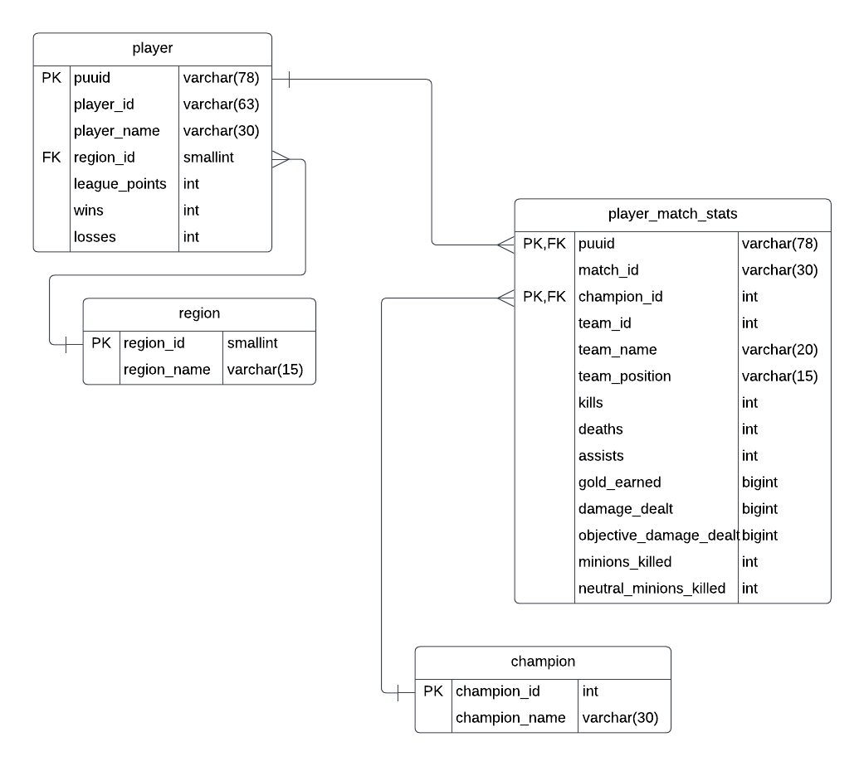
Database Design:
ERD

Slide 6
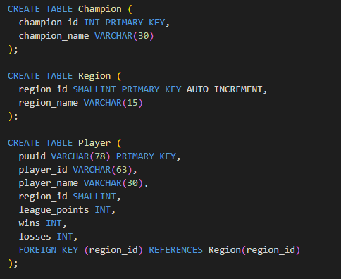
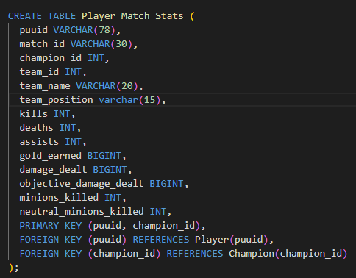
Database Schema

Slide 7
Functional Dependencies
Champion table:
champion_id -> champion_name (one-to-one)
Region table:
region_id -> region_name (one-to-one)
Player table:
puuid -> player_id (one-to-one)
puuid -> player_name (one-to-one)
puuid -> region_id (many-to-one)
Player_Match_Stats table:
puuid, champion_id -> match_id (one-to-many)
puuid, champion_id -> team_id (one-to-many)
puuid, champion_id -> team_name (one-to-many)
puuid, champion_id -> team_position (one-to-many)
puuid, champion_id -> kills (one-to-many)
puuid, champion_id -> deaths (one-to-many)
puuid, champion_id -> assists (one-to-many)
puuid, champion_id -> gold_earned (one-to-many)
puuid, champion_id -> damage_dealt (one-to-many)
puuid, champion_id -> objective_damage_dealt (one-to-many)
puuid, champion_id -> minions_killed (one-to-many)
puuid, champion_id -> neutral_minions_killed (one-to-many

Slide 8
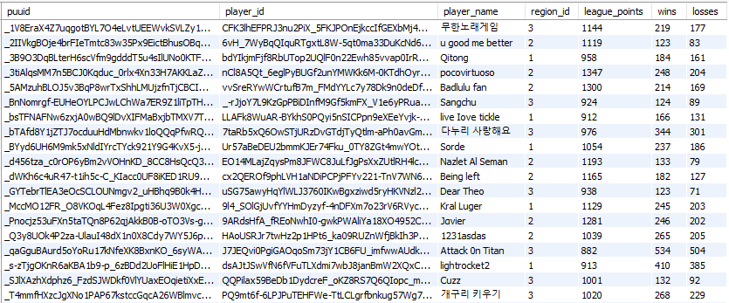
Example Data
Player table

Slide 9
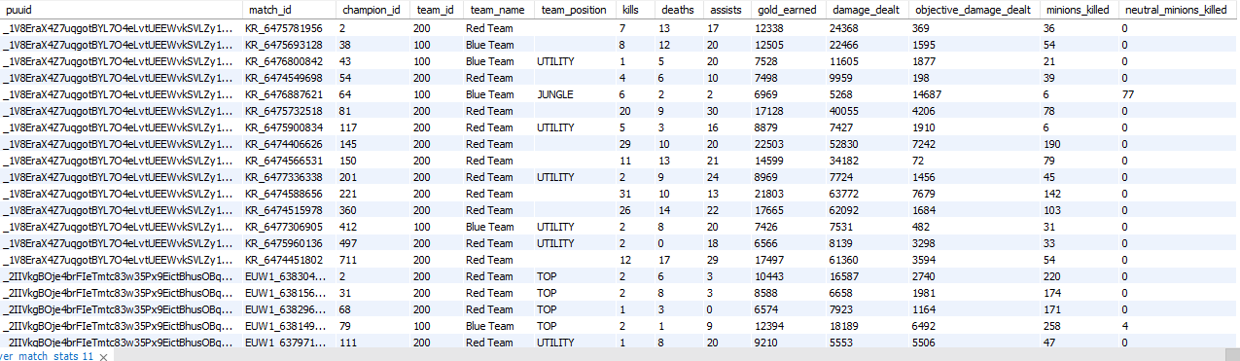
Example Data (cont)
Player_match_data table

Slide 10
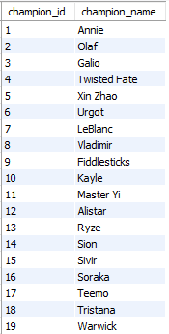
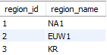
Example Data (cont)
Champion table
Region table

Slide 11
Normal Forms
Third Normal Form (3NF):
No transitive dependencies among non-key attributes.
Boyce-Codd Normal Form (BCNF):
No non-trivial functional dependencies where the determinant is not a candidate key or a superkey.
Fourth Normal Form (4NF):
The schema does not satisfy 4NF because there are multi-valued dependencies present in the Player_Match_Stats table. The columns team_id, team_name, and team_position are dependent on the match_id and not on the player_id or champion_id.

Slide 12
Aggregation Queries
1. TAKES PLAYERS AND ORDERS BY LP
SELECT
p.player_name,
r.region_name,
p.league_points,
SUM(p.wins) AS total_wins,
SUM(p.losses) AS total_losses
FROM
Player p
JOIN Region r ON p.region_id = r.region_id
GROUP BY
p.player_name,
r.region_name,
p.league_points
ORDER BY
league_points DESC;
2. TAKES PLAYERS AND ORDER BY WINS
SELECT
p.player_name,
r.region_name,
p.league_points,
SUM(p.wins) AS total_wins,
SUM(p.losses) AS total_losses
FROM
Player p
JOIN Region r ON p.region_id = r.region_id
GROUP BY
p.player_name,
r.region_name,
p.league_points
ORDER BY
total_wins DESC;

Slide 13
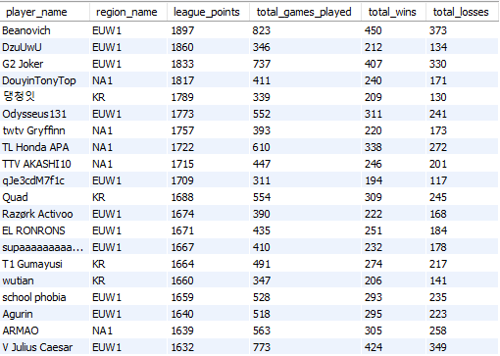
Aggregation Query 1
SELECT
p.player_name,
r.region_name,
p.league_points,
SUM(p.wins + p.losses) AS total_games_played,
SUM(p.wins) AS total_wins,
SUM(p.losses) AS total_losses
FROM
Player p
JOIN Region r ON p.region_id = r.region_id
GROUP BY
p.player_name,
r.region_name,
p.league_points
ORDER BY
p.league_points DESC;

Slide 14
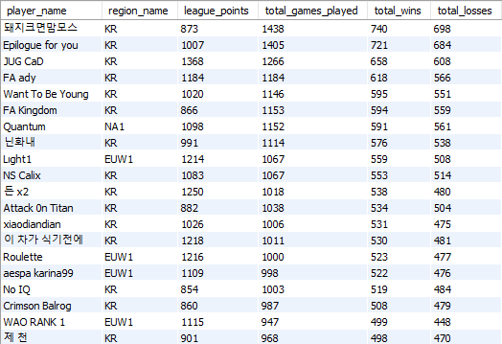
Aggregation Query 2
SELECT
p.player_name,
r.region_name,
p.league_points,
SUM(p.wins) AS total_wins,
SUM(p.losses) AS total_losses
FROM
Player p
JOIN Region r ON p.region_id = r.region_id
GROUP BY
p.player_name,
r.region_name,
p.league_points
ORDER BY
total_wins DESC;

Slide 15
Insert and Update Query Examples
INSERT INTO Region (region_name)
VALUES ('OC1')
INSERT INTO Player (puuid, player_id, player_name, region_id, league_points, wins, losses)
VALUES ('abc123', '123456', 'John Doe', 1, 1500, 50, 30);
UPDATE Player
SET league_points = league_points + 500
WHERE puuid = '12345'

Slide 16
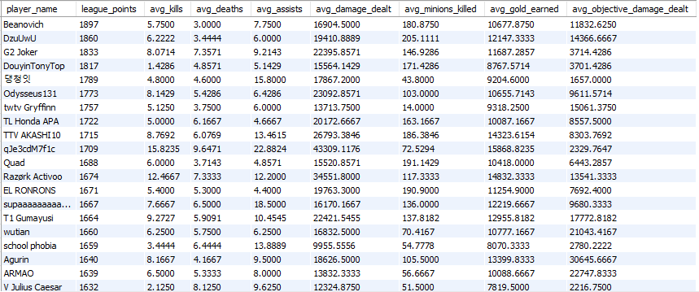
More Queries (AVG stats)
TAKES AVG PLAYER STATS ACROSS ALL GAMES AND ORDERS BY LP
SELECT p.player_name, p.league_points,
AVG(pms.kills) AS avg_kills,
AVG(pms.deaths) AS avg_deaths,
AVG(pms.assists) AS avg_assists,
AVG(pms.damage_dealt) AS avg_damage_dealt,
AVG(pms.minions_killed) AS avg_minions_killed,
AVG(pms.gold_earned) AS avg_gold_earned,
AVG(pms.objective_damage_dealt) AS avg_objective_damage_dealt
FROM Player p
INNER JOIN Player_Match_Stats pms
ON p.puuid = pms.puuid
GROUP BY p.player_name, p.league_points
ORDER BY p.league_points DESC;

Slide 17
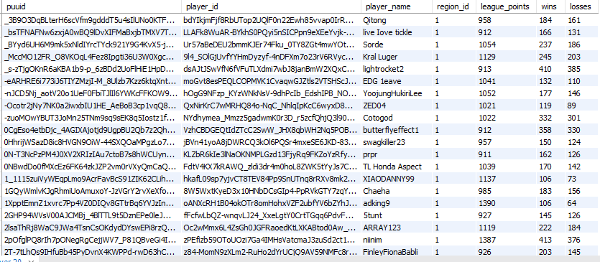
Subquery Query (sorting by region)
SORTS THE LIST OF PLAYERS BY REGION
SELECT *
FROM Player
WHERE region_id IN (
SELECT region_id
FROM Region
WHERE region_name = 'NA1'
);

Slide 18
Other Queries
SELECT Player.player_name,
Region.region_name,
Player_Match_Stats.team_id,
Player_Match_Stats.team_name,
Player_Match_Stats.team_position,
Player_Match_Stats.kills,
Player_Match_Stats.deaths,
Player_Match_Stats.assists,
Player_Match_Stats.gold_earned,
Player_Match_Stats.damage_dealt,
Player_Match_Stats.objective_damage_dealt,
Player_Match_Stats.minions_killed,
Player_Match_Stats.neutral_minions_killed
FROM Player_Match_Stats
JOIN Champion ON Player_Match_Stats.champion_id = Champion.champion_id
JOIN Player ON Player_Match_Stats.puuid = Player.puuid
JOIN Region ON Player.region_id = Region.region_id
WHERE Champion.champion_name = 'Pantheon'
ORDER BY Player_Match_Stats.damage_dealt DESC;
This Query will avg all the stats of the players who played a specific champion for comparison. Just needs a champion name placed for the third to last line, ill use Pantheon or this example since he was an impactful champion during patch 13.9.

Slide 19
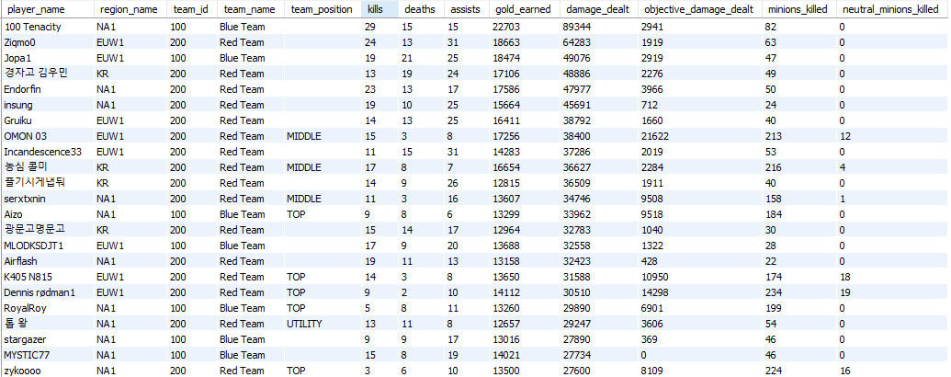
Pantheon Player Analysis
A lot of these games are from NA1 or EUW1 which can display how different popular champions can vary from region to region

Slide 20
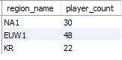
Other Queries (Cont)
SELECT
r.region_name,
COUNT(*) AS player_count
FROM
(SELECT * FROM Player ORDER BY league_points DESC LIMIT 100) p
JOIN Region r ON p.region_id = r.region_id
GROUP BY
r.region_name;
Utilizing this query we are able to order the players by their LP and take the top 100 of them and see what region they are from. Based on this query, if total LP ends up being a deciding factor in skill then this query’s relevance will grow.

Slide 21
Questions looking to answer
Are wins a good judge of skill?
Which stats correlate with a higher rank?
Which region is better at the game?
If we are using the total amount of LP as the determining factor of skill, since the goal is to be the highest rank, then these questions will be analyzed in that regard. Lets dive into each question individually and use old and new queries to help answer them!

Slide 22
Analysis (Are wins a good judge of skill?)
Using the previous queries:
1. TAKES PLAYERS AND ORDERS BY LP
SELECT
p.player_name,
r.region_name,
p.league_points,
SUM(p.wins + p.losses) AS total_games_played,
SUM(p.wins) AS total_wins,
SUM(p.losses) AS total_losses
FROM
Player p
JOIN Region r ON p.region_id = r.region_id
GROUP BY
p.player_name,
r.region_name,
p.league_points
ORDER BY
p.league_points DESC;
2. TAKES PLAYERS AND ORDER BY WINS
SELECT
p.player_name,
r.region_name,
p.league_points,
SUM(p.wins + p.losses) AS total_games_played,
SUM(p.wins) AS total_wins,
SUM(p.losses) AS total_losses
FROM
Player p
JOIN Region r ON p.region_id = r.region_id
GROUP BY
p.player_name,
r.region_name,
p.league_points
ORDER BY
total_wins DESC;
We are able to compare the amount of wins and league points to see if there are some correlations

Slide 23
Analysis (Are wins a good judge of skill?)
Looking at the resulting table we can see that the spread on the regions is favoring EUW1 more than the rest, which we can see using this reused query
which shows that the top 100 players sorted by LP has almost half being from EUW1.
SELECT
r.region_name,
COUNT(*) AS player_count
FROM
(SELECT * FROM Player ORDER BY league_points DESC LIMIT 100) p
JOIN Region r ON p.region_id = r.region_id
GROUP BY
r.region_name;

Slide 24
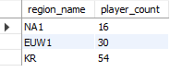
Analysis (Are wins a good judge of skill?)
2.
BUT this resulting table shows why that stigma exists. This table displays how many games the Koreans play in total.
Now adjusting the previous query
to sort by wins instead we get an interesting resulting table. Now Korea has the lead with over half for the top 100 sorted by wins. These tables represent the sheer amount of games and experience Koreans have.
SELECT
r.region_name,
COUNT(*) AS player_count
FROM
(SELECT * FROM Player ORDER BY wins DESC LIMIT 100) p
JOIN Region r ON p.region_id = r.region_id
GROUP BY
r.region_name;

Slide 25
Analysis (Which stats correlate to rank?)
In order to see if particular stats correlate with rank, I’ll use a previous query
which takes average player stats across all games and orders them by LP. Then after averaging we can analyze.
SELECT p.player_name, p.league_points,
AVG(pms.kills) AS avg_kills,
AVG(pms.deaths) AS avg_deaths,
AVG(pms.assists) AS avg_assists,
AVG(pms.damage_dealt) AS avg_damage_dealt,
AVG(pms.minions_killed) AS avg_minions_killed,
AVG(pms.gold_earned) AS avg_gold_earned,
AVG(pms.objective_damage_dealt) AS avg_objective_damage_dealt
FROM Player p
INNER JOIN Player_Match_Stats pms
ON p.puuid = pms.puuid
GROUP BY p.player_name, p.league_points
ORDER BY p.league_points DESC;

Slide 26
Analysis (Which stats correlate to rank?)
Looking at the graph in the previous slide and even when scrolled past the initial 20, a correlating stat to rank can not be determined. Meaning that no conclusion can be drawn from this question which is still beneficial information. These stats are just too random, which align with the fact that the game has so many different variables that these stats cant represent, like movement and positioning, mechanics, map awareness and presence, champion matchups, team compositions, etc.

Slide 27
Analysis ( Which region is better at the game?)
Based on both of the previous question, if judging by LP then EUW1
If judging by wins/experience then KR

Slide 28
Conclusions
Based on the comparison of LP to wins we were able to determine that EUW1 has the most players with high LP meaning their win/loss ratio is high which is a good indicator for skill. While KR has an intense amount of games played, most likely based on standards implemented by schools or teams in pro play. The player with the most LP has around 1900 and is from EUW1 and has 450 wins, while the player with the most wins was from KR and has around 900 LP with 740 wins out of over 1400 games! The analysis of the stat averages did not yield much information aside from the fact that the lack of correlation between LP and these stats, or even wins and these stats implies there are more factors to winning or being good then these stats.

Slide 29
Issues
Python Script
Riot API request pull speed
RiotWatcher
Me and my brain

